Slide 1
TOMATO
( Food Delivery Website )
Submitted To:
Dr. Baljit Kaur
Mr. Vikas Patel
Submitted By:
Team No. 7
Karan Kumar Garg (478)
Jatin Saini (460)
Joyash Sood (466)
Kartavya Tomar (484)

Slide 2
Table of Contents:
Introduction
Overview
Tools used
Bonus Feature(optional)
Key Features
Conclusion
References/Links used

Slide 3
Introduction
Welcome to TOMATO, your ultimate destination for hassle-free food ordering online!
Whether you're craving a sizzling pizza, a gourmet burger, or a fresh salad, we've got you covered.
With an extensive selection of restaurants and cuisines, finding your favorite flavors is easier than ever.
Our user-friendly website makes ordering a breeze, allowing you to customize your meal, track your delivery, and enjoy convenient payment options.
Plus, our seamless interface ensures a smooth experience from start to finish.
Say goodbye to long wait times and hello to delicious meals delivered right to your doorstep.
Discover the joy of effortless dining with Tomato today!

Slide 4
OVERVIEW
Introducing Tomato, your go-to platform for culinary convenience and delicious discoveries.
With Tomato, exploring a world of flavors has never been easier.
Browse through a diverse array of restaurants and cuisines, from local favorites to international delights, all in one convenient place.
Our user-friendly interface lets you effortlessly place orders, customize your meals, and track delivery in real-time.
Whether you're craving a hearty meal for dinner or a quick snack for lunch, Tomato has something for every palate and every occasion.
Say goodbye to cooking stress and hello to culinary bliss with Tomato – your trusted companion for satisfying cravings, one bite at a time.

Slide 5
TOOLS and Languages
Here are all the tools and languages used to build Spoileriffic:
VsCode
Web Browser
React js
Next js
Javascript
Css
HTML

Slide 6
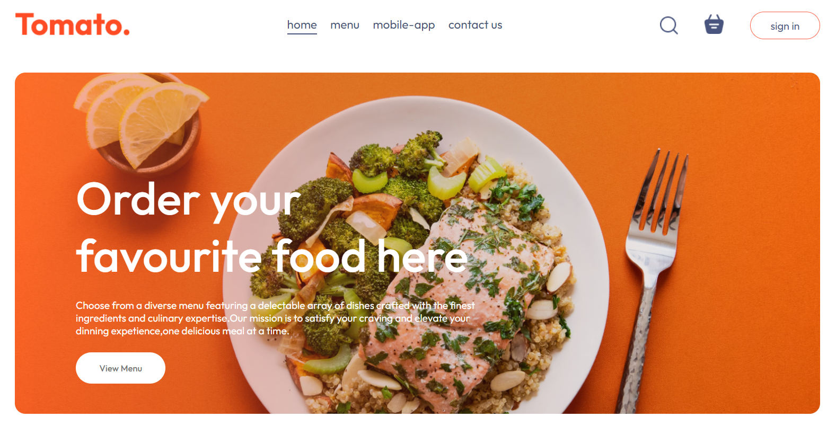
HOME

Slide 7
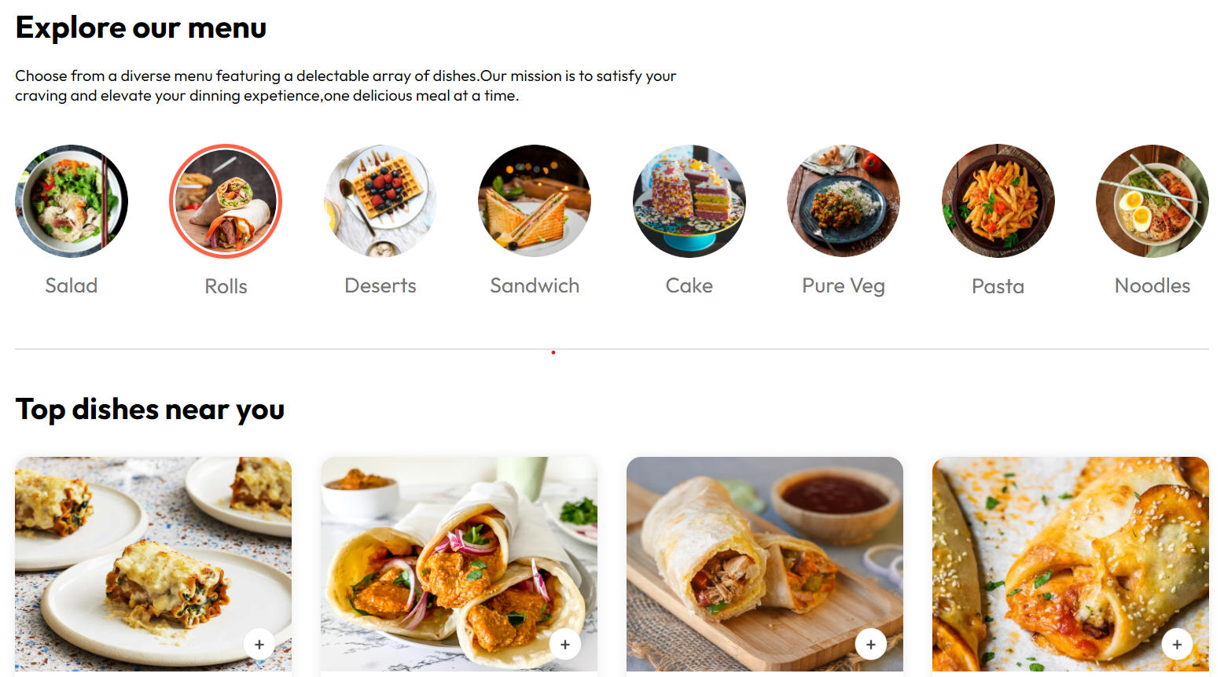
MENU

Slide 8
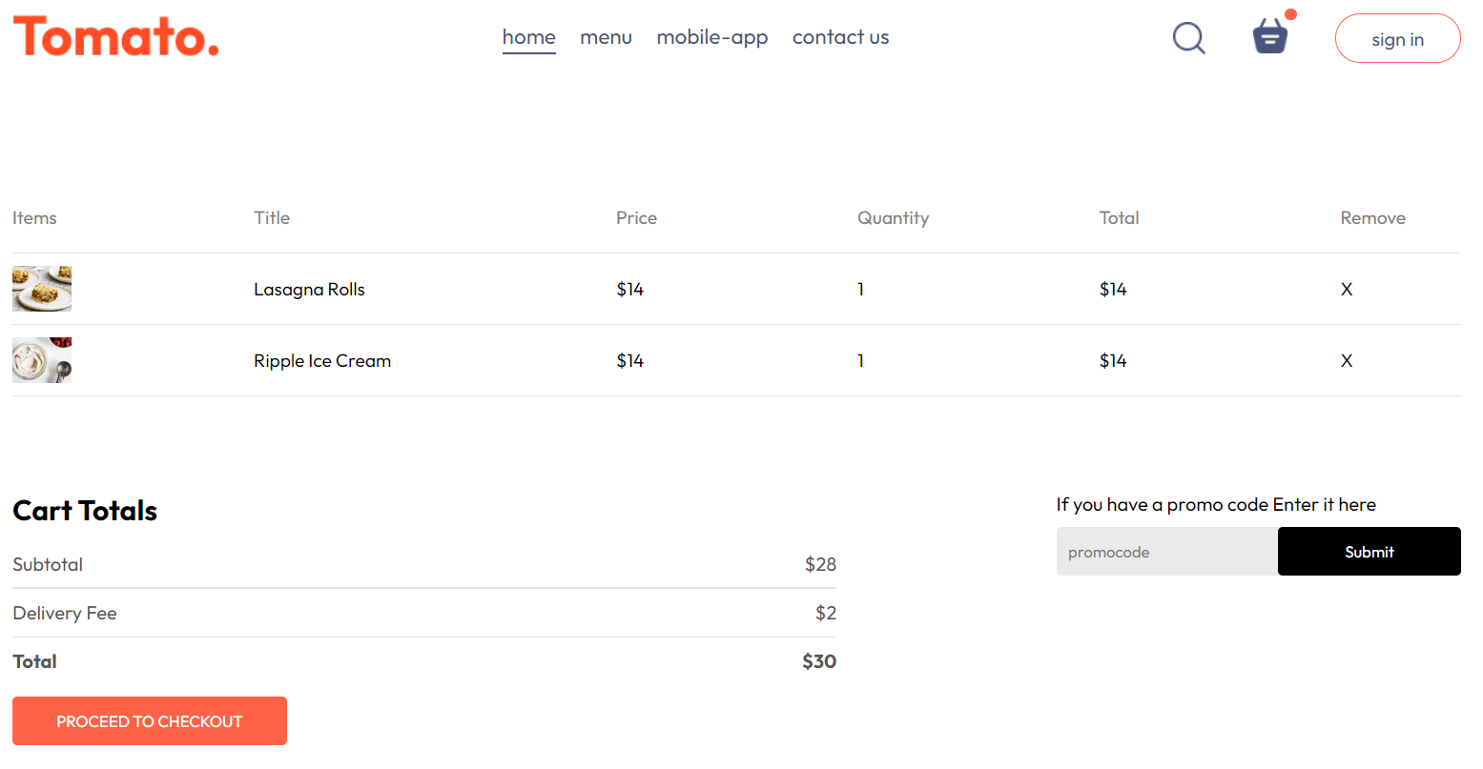
CART

Slide 9
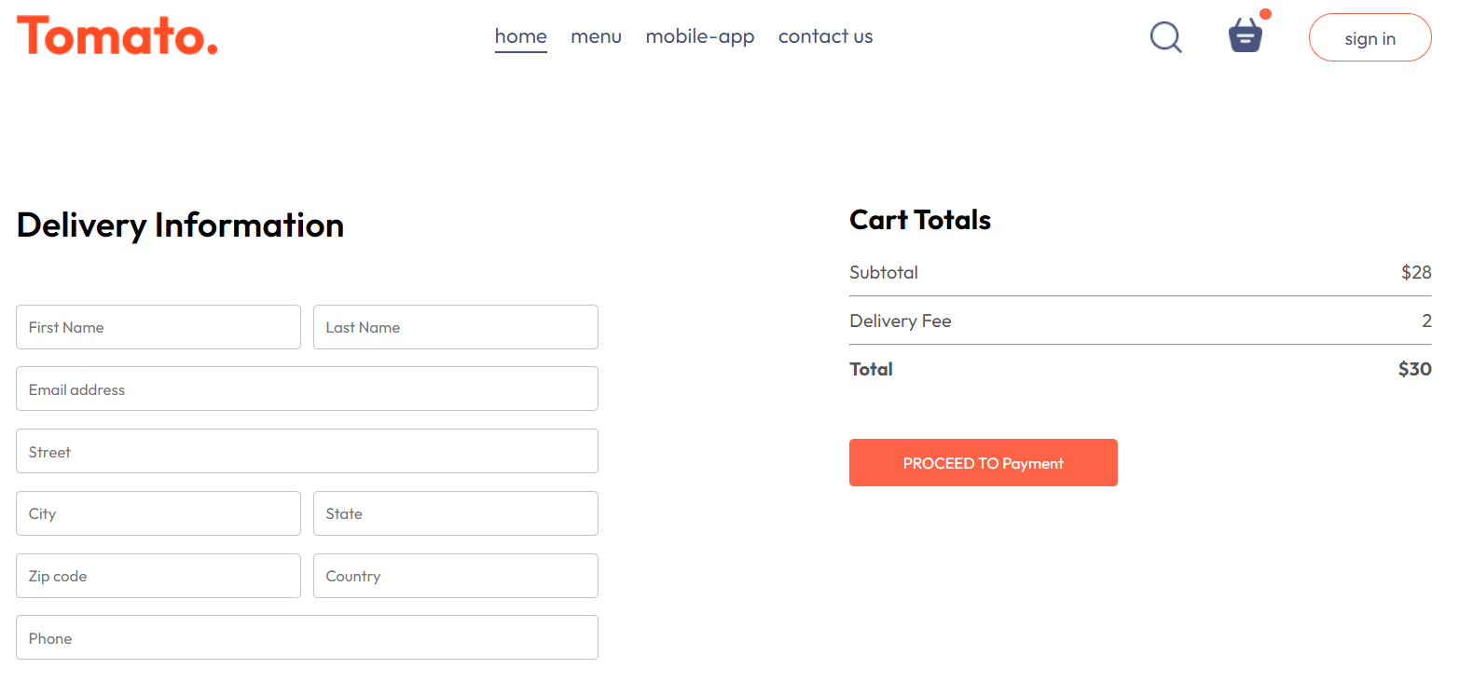
Delivery Info

Slide 10
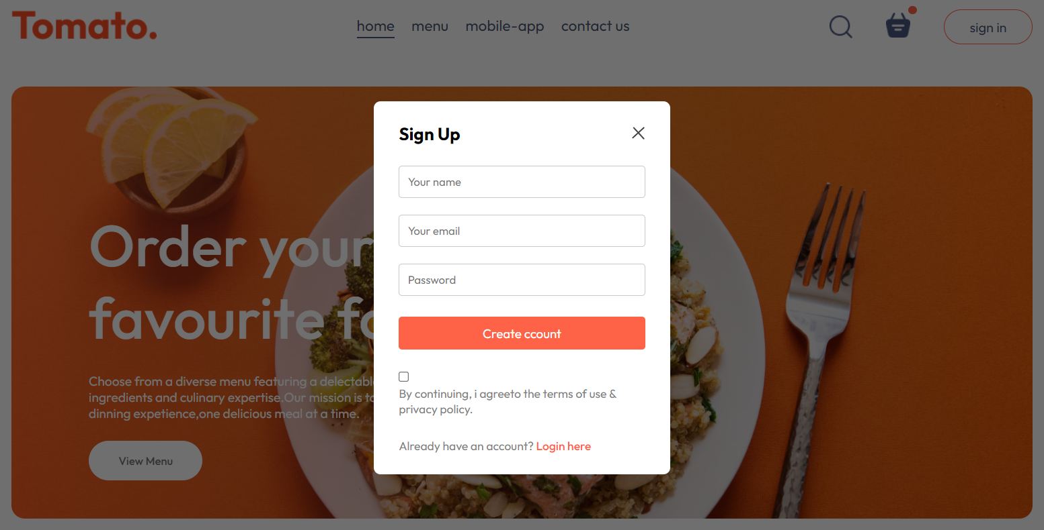
Sign Up Page

Slide 11
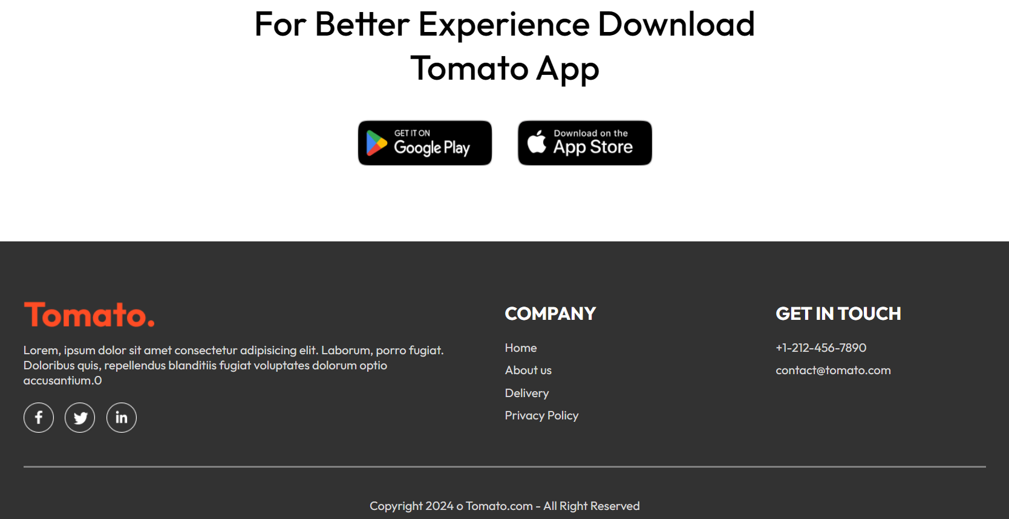
CONTACT US

Slide 12
Bonus Features-
Our project provides a feature to store the user’s selected food items so that they can check their order anytime, anywhere.
We also keep records of their ‘recently ordered’ food items so that they can access their past orders and reorder them again if required.
We provide a feature for ‘liked dishes’ which enables them to see all their selected liked food items.

Slide 13
Conclusion-
The project was a food ordering Web, which involved designing and developing software to make orders, search food items on web.
Key features of TOMATO include -:
Browse Menu Add to Cart
Secure Payment Gateway Reviews and Ratings
Responsive Design Special Offers and Discounts
Feedback Mechanism Sign Up Feature

Slide 14
References/Links used
W3 Schools - https://www.w3schools.com/
MDN Web Docs - https://developer.mozilla.org/en-US/
Tutorials Point - https://www.tutorialspoint.com/index.html
css-tricks - https://css-tricks.com/
Geeksforgeeks - https://www.geeksforgeeks.org/

Slide 15


